Slide 1
Implementing Computation Across the Curriculum
Todd Zimmerman
University of Wisconsin – Stout
Beyond the First Year Conference III - 2018

Slide 2
Talk Outline
Three-legged stool
Computation in the workplace
Progress in implementing computation
Why computation should be included in the curriculum
Hurdles to implementing computation
Possible solutions to overcoming hurdles
Future directions

Slide 3
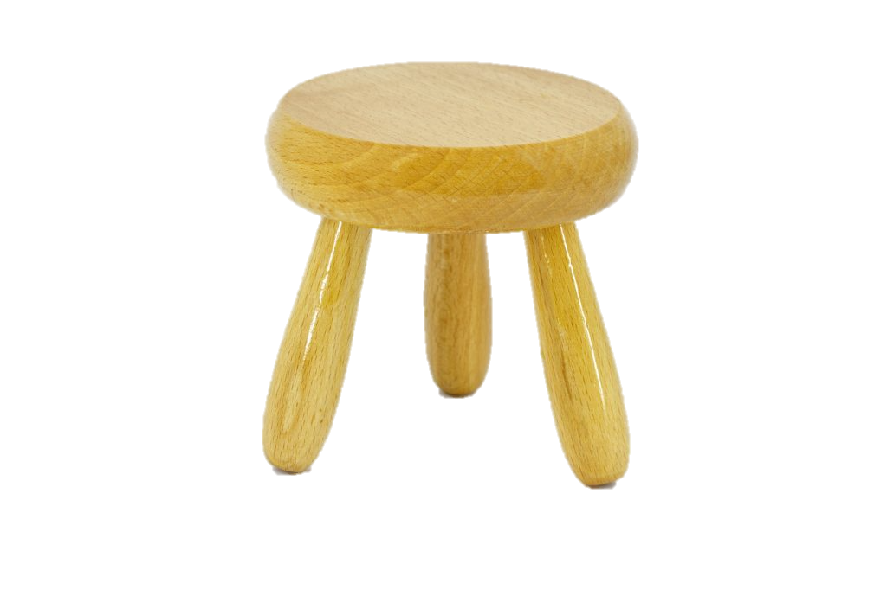
Three-Legged Stool
Physics
Theory
Experiment
Computation
[Three-legged stool]. (n.d.). Retrieved July 23, 2018, from https://marketvolt.com/2017/05/marketing-is-a-three-legged-stool/

Slide 4
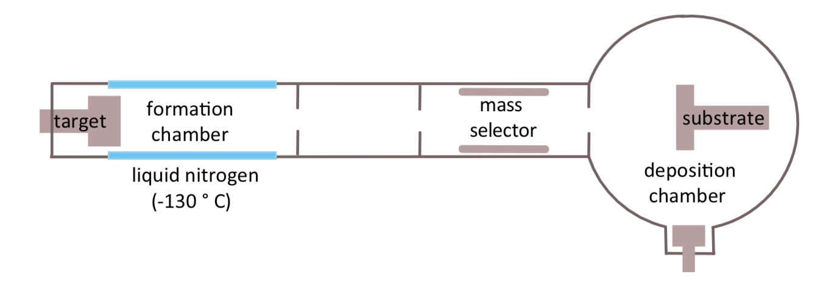
Inert Gas Condensation of Nanomagnets
How do magnetic nanoclusters form in argon plasma?
Computational modeling required
Notes:
2017 Nobel prize in physics was for observation of gravitational waves, which would not have been possible without computational data analysis
The 2015 prize in physics was for the discovery of neutrino oscillations, which again required significant data analysis and modeling.
Nobel prize in chemistry in 2013 was for computational modeling of molecules

Slide 5
Computation in the Workplace
A little less than half of bachelors graduates seek industry positions
Bachelors students in industry report 75%-90% are programming and 50%-60% are performing modeling and simulation
Based on 2017 AIP "Physics Bachelors: Initial Employment” report which is based on survey data from 2013-2014
Question: Who should we be serving and how do we best serve them?
Notes:
41% seek industry jobs while 54% go to grad school
Students in grad school obviously need to know programming too
Do we focus on the highest bar (grad-school-bound students) or on the broadest audience (grad school plus industry)

Slide 6

Partnership for the Integration of Computation into Undergraduate Physics - Goals
Create community of educators
Faculty development workshops
AAPT Workshops
Come to your department
Collect resources, strategies, and tactics to integrate computation across the curriculum
gopicup.org
Notes:
Founded by Norman Chonacky and David Winch

Slide 7
What does “integration of computation across the curriculum” mean?
Inclusion of computational projects and exercises across the various courses in the curriculum in an intentional and coherent fashion
Use computational physics thinking in all courses
Notes:
Using computers to conduct tasks that you couldn’t otherwise accomplish
Does not necessarily mean programming but rather making use of programs, however programming can make up an important part of the curriculum.
Includes everything from using simulations, having students modify working code, giving students templates to work from, all the way up to writing code from scratch

Slide 8
Computational Physics Thinking
Translate a model into code
Choose scales and units
Subdivide a model into a set of manageable computational tasks
Choose algorithms and computational tools
Debug, test, and validate code
Extract physical insight.

Slide 9
We’ve made progress
Amount of computation in curriculum has improved since survey in 2006
50% of departments report at least half of faculty members assigning computational homework and a similar percentage assigning computational projects
63% of departments have at least one faculty member requiring computational homework
In 2006 39% of departments reported 20% of faculty included computation in their grading
Less than 25% have half of faculty assessing computation on exams (35% report at least one faculty member doing this)

Slide 10
Why do you think computation should be included in the curriculum?

Slide 11
Why do you think computation should be included in the curriculum?
Exploration of complex systems
Develop understanding and intuition of systems beyond the few systems we can solve analytically
Data-driven discoveries and Big Science
Data science and machine learning
Give students marketable skills
Notes:
E.g. In classical mechanics we can solve constant force, linear force (SHO), and two-body central forces. Must use computation for anything else

Slide 12
What hurdles do you see to implementing computation across the curriculum?

Slide 13
What hurdles do you see to implementing computation across the curriculum?
PER systemic implementation hurdles
Student resistance
Time structure
Departmental norms
Expectation of content coverage
Lack of instructor time
Computation systemic implementation hurdles
Lack of instructor knowledge
Accessible platform
The IT crowd
Notes:
Insert references to Charles and Danny’s stuff

Slide 14
Overcoming hurdles
Recognize the hurdles
Achieve buy-in
From other faculty
From administrators
From students
Develop common learning goals
Develop curricular material
Notes:
J-TUPP and AAPT Recommendations on Computation are strong tools for arguing for more computation.

Slide 15
A parting thought…
Pen & Paper
Computation
Where does the ideal balance of computation and pen & paper work lie?
Notes:
By pen & paper I mean analytical methods for solving problems that can be done on paper while computation refers more to numerical methods
A colleague warned me about bringing this up fearing I would be branded some sort of computational purist. I am not advocating a particular view, just posing the question

Slide 16
Where have all the slide rules gone?
Slide rules grant a deeper understanding of relationships between numbers
Why don’t we use them anymore?
By s58y (Keuffel & Esser slide rule, model 4081-3) [CC BY 2.0 (https://creativecommons.org/licenses/by/2.0)], via Wikimedia Commons
Notes:
Was the loss of intuition and insight gained from the slide rule worth the benefits of electric calculators?

Slide 17
A parting thought…
Pen & Paper
Computation
Where does the ideal balance of computation and pen & paper work lie?
Notes:
I think the balance lies closer to the computation side but this is gut instinct and we all know what eventually comes out of our gut. My challenge to you is “prove it”. Where does the ideal balance lie? How far towards one extreme or the other do we need to be to best serve our students?
One argument frequently given against relying more on computation is that the algorithms and code tend to be black boxes, but I’d argue that at the introductory level both computation AND hand-calculations are equally black boxes.

Slide 18
Possible ALpHA/PICUP Immersion in 2019
Contact Lowell McCann or Kelly Roos for more information.

Slide 19
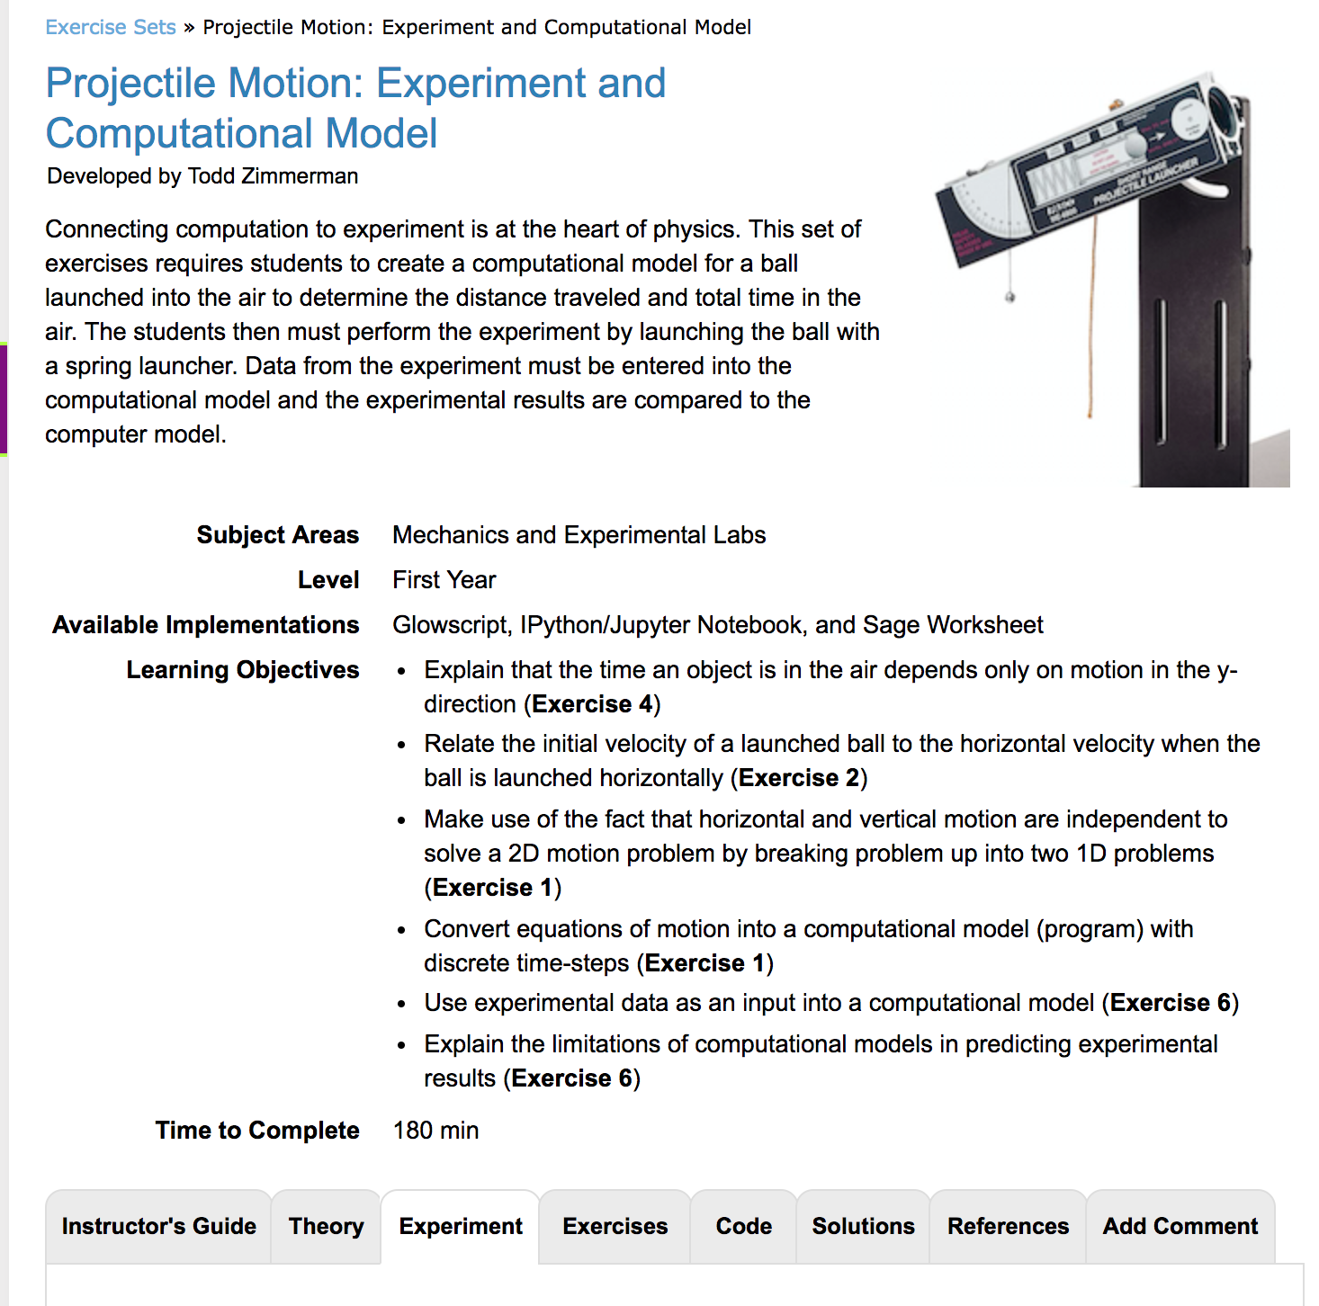
Experiment Tab
Exercise sets on gopicup.org
Notes:
We’ve added a new experiment tab to the PICUP exercise sets. This feature isn’t live yet but we envision it to be a tab where you can upload material including pdfs or other documents or link to experimental descriptions elsewhere to describe experiments that accompany computational activities.

Slide 20
My challenge to you…
Answer the following:
How can you best serve your students’ need for computational skills?
Are you serving your students?
What is the best balance of pen & paper methods and computational methods to develop understanding and insight?

Slide 21
Thank you
Thanks to the following for funding:
Dept. of Chemistry and Physics, UW-Stout
College of Science, Technology, Engineering, Mathematics, and Management Dean
Slides and links to references at:

